Slide 1
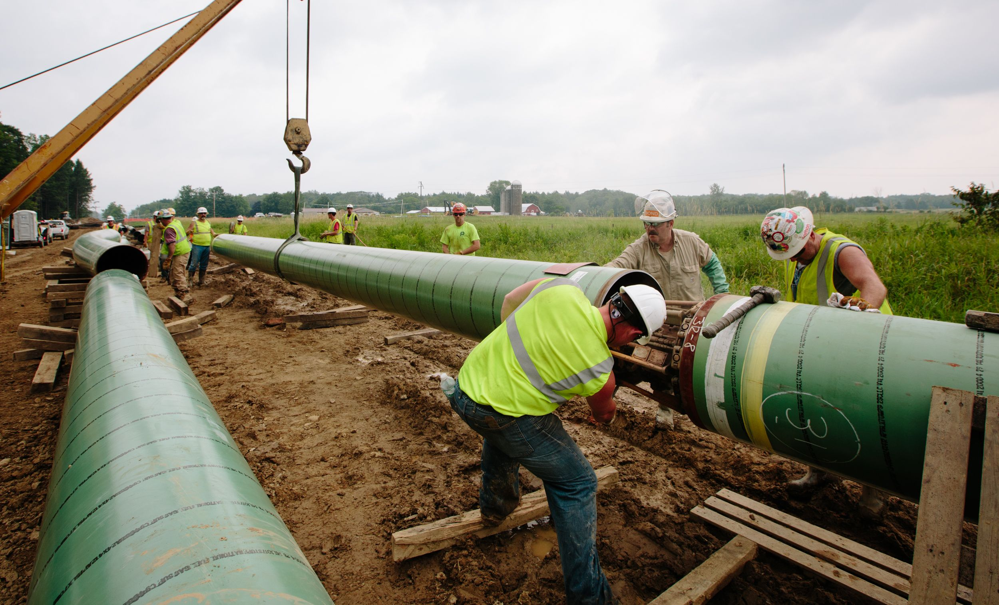

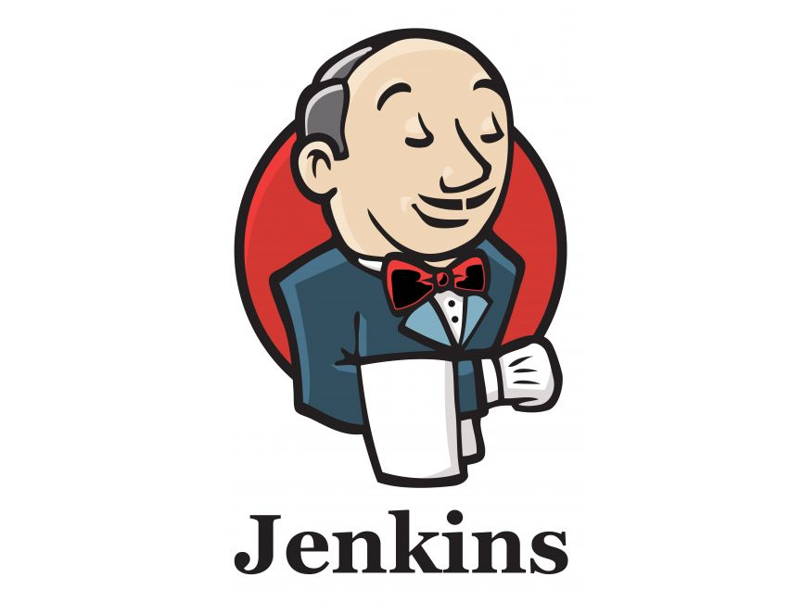

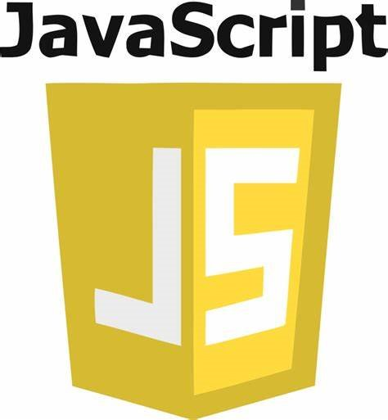


Mini Onboarding
- DevOps Pipeline -

Slide 2
Contents
What is the Pipeline?
Pipeline Tools - Jenkins - SonarQube - Moodle
Unity Pipelines
JS Pipelines
Azure Servers

Slide 3




1. What is pipeline?

Slide 4
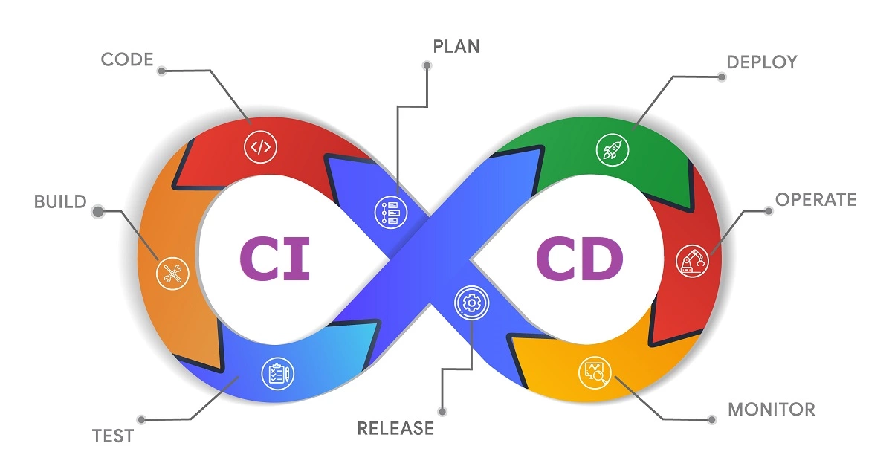
1. What is pipeline?
Continuous Integration (CI)
CI / CD Pipeline
Automated Testing : Every integration(PR) triggers Jenkins pipeline based on the PR created project to catch potential bugs and regressions
Automated Builds : Every integration triggers an automated build process to ensure the code compiles successfully
Immediate Feedback : Developers receive feedback on their work and can review it with their team before merging the change
Continuous Delivery (CD)
Automated Deployment : The project will be automatically deployed to the target platform based on its configuration.
Version Control : Pipelines manage and store deployed projects based on the version control of each project.

Slide 5
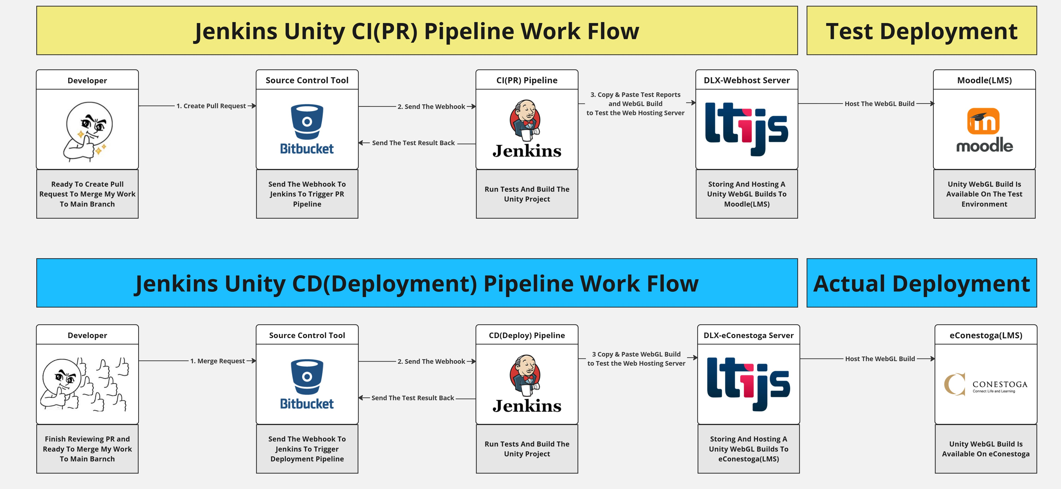
1. What is pipeline?
Pipeline Workflow

Slide 6

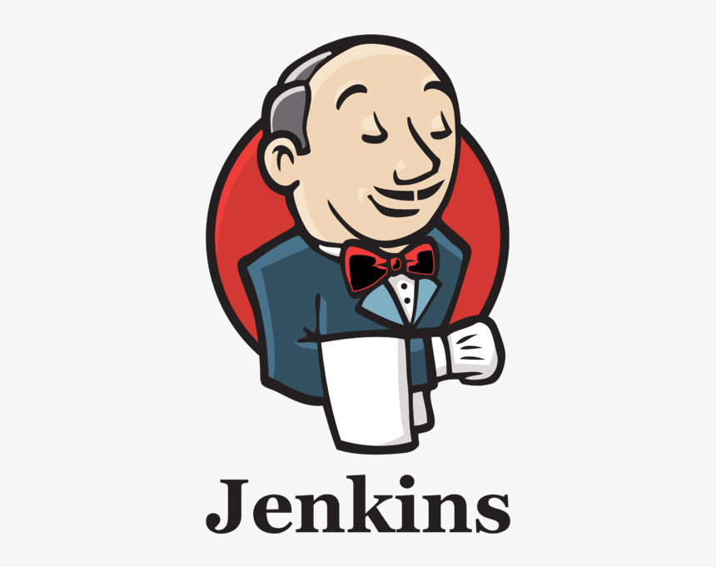

2. Pipeline Tools

Slide 7
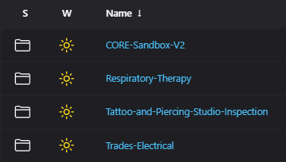
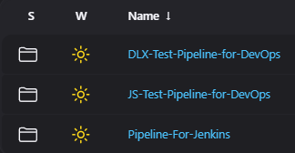
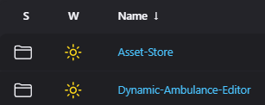
1. About Jenkins
: Currently, our Jenkins has three different characteristics of pipelines.
Unity Pipelines
Web Development Pipelines
Test Pipelines
Pipelines for ongoing Unity projects
Pipelines for Java Script based projects
DevOps test and development environment
Isolated trouble shooting environment
Pipeline for Jenkins scripts

Slide 8
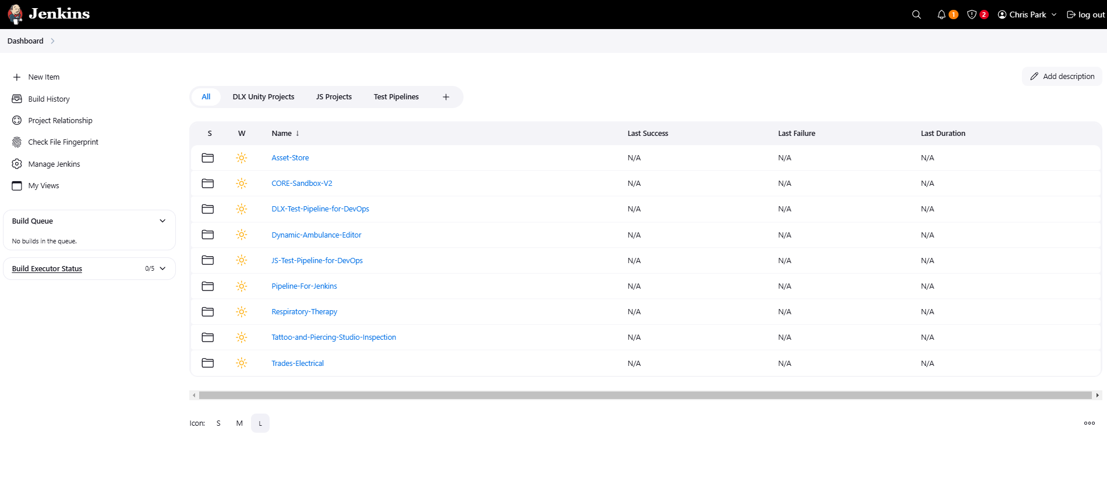
Jenkins (Dash Board)
Security or Update alarm
Create a new project folder or pipeline
Jenkins system configuration page
Customized View
List of builds waiting to be run
List of builds currently running
Project folders

Slide 9
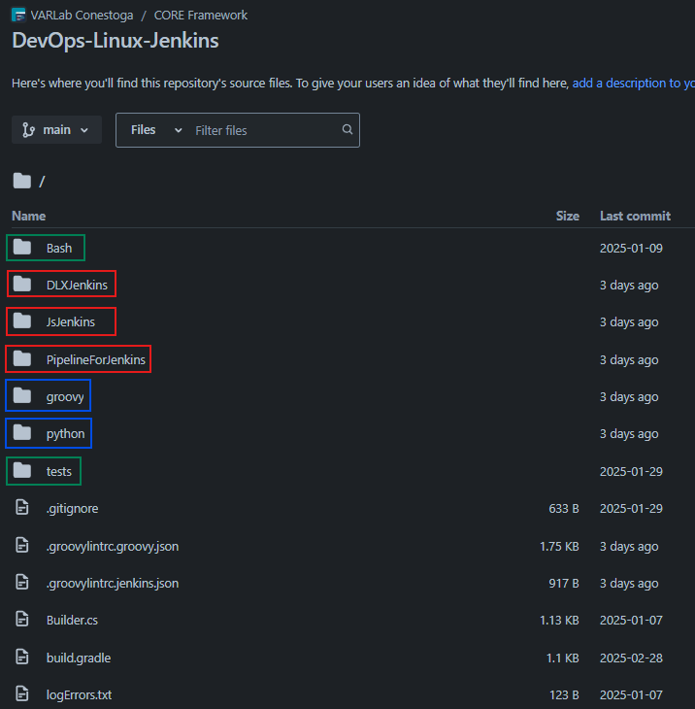
Jenkins (Pipeline Scripts)
Main Files
Helper Files
[./DLXJenkins]
Jenkinsfile
JenkinsfileDeployment
[./groovy]
GeneralHelper.groovy
unityHelper.groovy
jsHelper.groovy
[./JsJenkins]
Jenkinsfile
JenkinsfileDeployment
[./python]
send_bitbucket_build_status.py
linting_error_report.py
create_bitbucket_coverage_report.py
create_bitbucket_test_report.py
create_bitbucket_webgl_build_report.py
…..
[PipelinesForJenkins]
Jenkinsfile
.groovylintrc.groovy.json
.groovylintrc.jenkins.json
Test and Lint Files
[./Bash]
Linting.bash
[./tests]
GeneralHelperSpec.groovy
JsHelperSpec.groovy

Slide 10
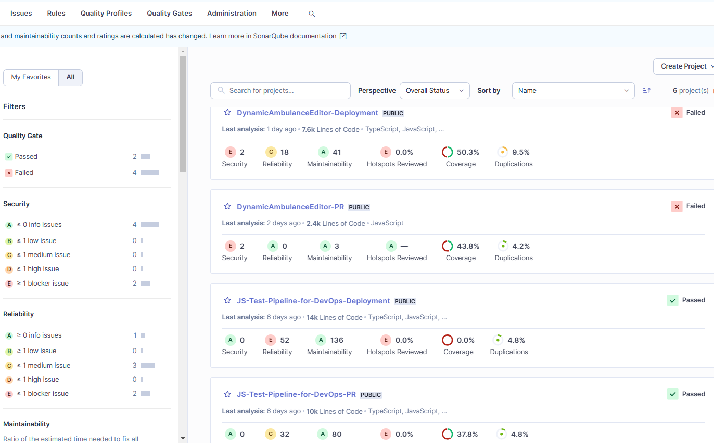
SonarQube (Static Code Analysis)
SonarQube Dashboard
SonarQube is installed on the Jenkins server and accessible at the '/sonar' endpoint.
It scans project source files and collects test results for static code analysis.
It generates analysis reports for developers with detailed error messages and source code links.
[Summary]
Code Duplication
Security Issue
Maintainability
Coverage Rate Tracing

Slide 11
Moodle (Test Deployment Platform)
What is Moodle?
: Moodle is the test deployment server for the DLX projects. Moodle is the same LMS platform as eConestoga, so we can test the WebGL build and LTI API before uploading builds to eConestoga.
The DevOps team mainly uses this platform for LTI integration testing and development
We can create courses, content, and assignments to mimic the eConestoga environment
LMS: Learning Management System
LTI: Learning Tool Interoperability

Slide 12


3. Unity Pipelines

Slide 13


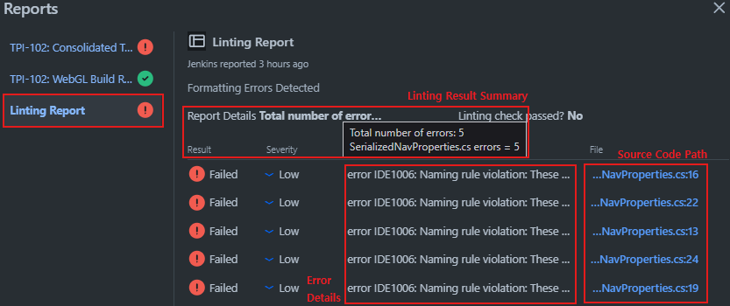
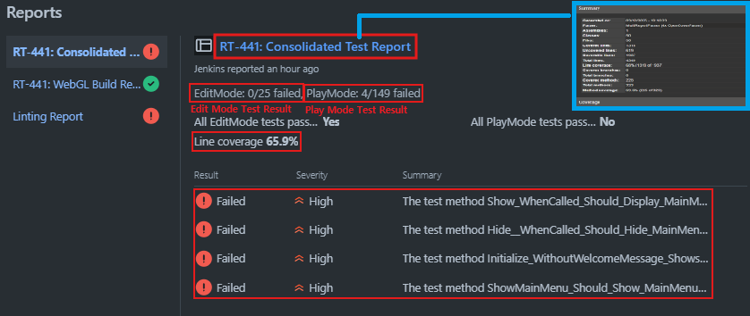

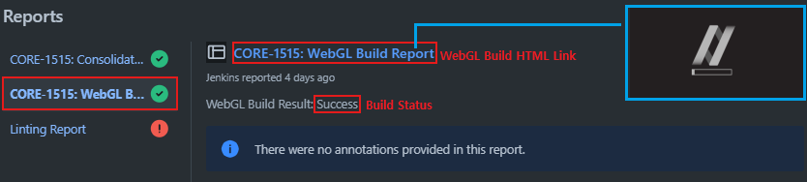
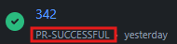
Unity PR Pipeline
Prepare Workspace - Check merge conflict - Check-out to PR branch and pull - Send Build status to PR branch on Bitbucket
Pipeline Build Status
- Build Status -
Linting Report
Linting - Check lint rule violation - Send lint report to Bitbucket
- Bitbucket PR Page -
Consolidated Test Report
Edit Mode Test - Run edit mode test on batch mode - Generate test result xml
- Linting Report -
WebGL Build Report
Pipeline Build Status
Play Mode Test - Run play mode test on batch mode - Generate test result xml
Send Code Coverage HTML
- dlx-webhost Server -
Send WebGL Build and Log File
Code Coverage - Generate code coverage report - Send code consolidated report to Bitbucket - SCP code coverage report to webhost server
- Consolidated Test Report -
Build Project - Build WebGL on batch mode - Send WebGL build report - SCP WebGL build to webhost server
- WebGL Build Report -
Clean Up Workspace - Return to the main branch - Send Build status to PR branch on Bitbucket
- Build Status -

Slide 14
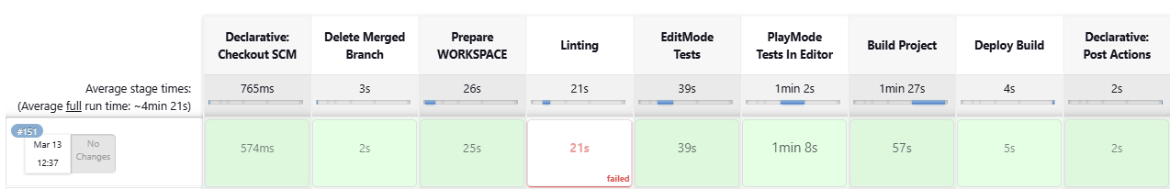
Unity Deployment Pipeline
Delete Merge Branch Stage
Deploy Build Stage
: This stage removes the artifacts (mostly log files) generated during the PR pipeline process from the working directory of the triggered PR branch.
: The WebGL build will be copied to the Web Root Directory of the dlx-econestoga server.
The dlx-econestoga server is an internal server of VARLab
Builds will not be deployed if there are any test failures
The WebGL build must include an 'LTI Package' for a successful deployment
For example, if the name of PR branch is 'CORE-123-Pipeline,'
>> {WORKSPACE}/{PROJECT_NAME}/{PR_PIPLEINE}/PR_Job/CORE-123-Pipeline/
This directory will be deleted.

Slide 15
4. JS Pipelines

Slide 16
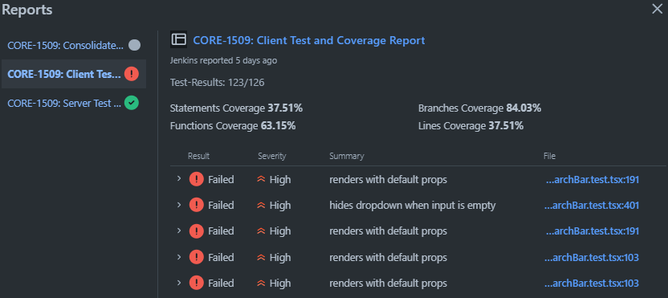
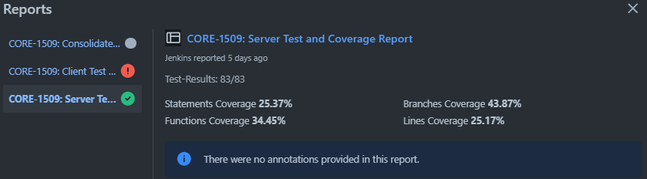
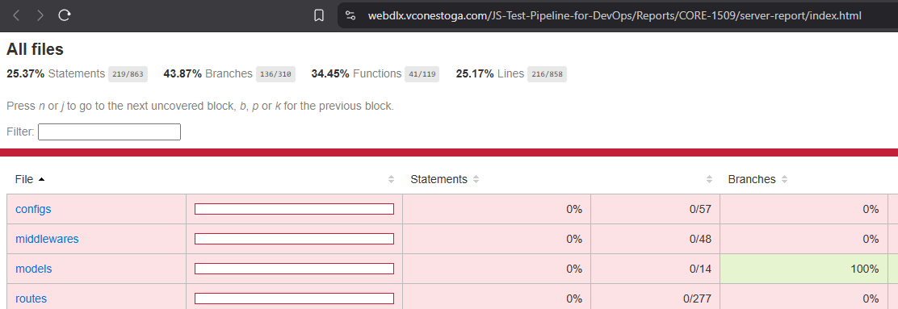
Web Dev PR Pipeline
Pipeline Build Status
Prepare Workspace - Check merge conflict - Check-out to PR branch and pull - Send Build status to PR branch on Bitbucket
- Build Status -
- Bitbucket PR Page -
Install Dependency - Check node version - "npm audit" - "npm install"
Send Test Reports (Server & Client)
Pipeline Build Status
Linting - Check lint rule violation - "npm run lint" >> eslint-report.json
- Client Project Test Reports -
Send Code Coverage HTML
- dlx-webhost Server -
Unit Testing - Run Jest unit test for client project - Run Vitest unit test for server project
- Server Project Test Reports -
HTTP GET: Retrieve Analysis Results
Static Analysis - Reterive static code analysis result from the SonarQube server
Response with JSON Object
- Local SonarQube Service -
Clean Up Workspace - Return to the main branch - Send Build status to PR branch on Bitbucket
- Code Coverage HTML -
- Build Status -

Slide 17
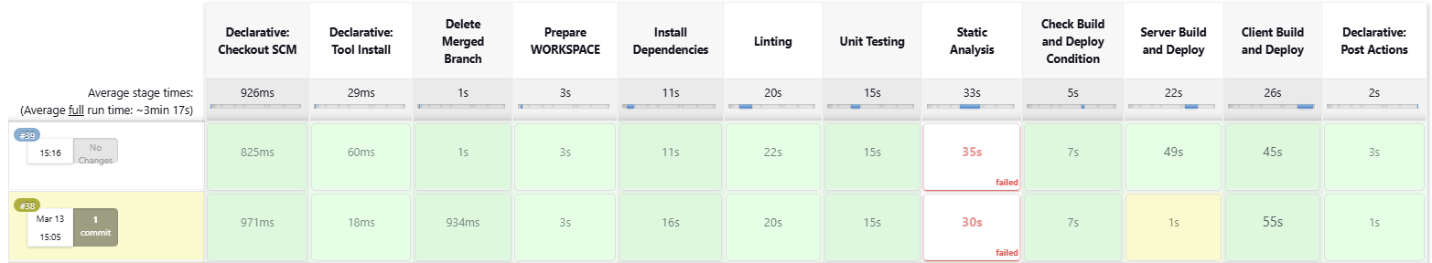
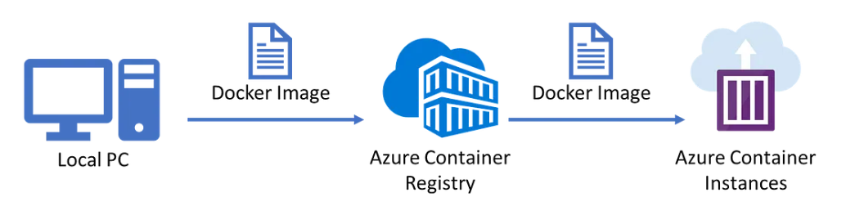
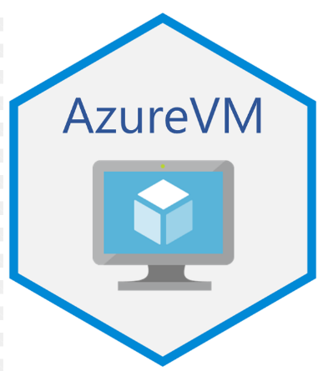
Web Dev Deployment Pipeline
Check Build and Deploy Condition Stage
Build and Deploy Stages
: Check whether Docker is running and whether the Azure Container Registry (ACR) is accessible.
: Check whether the version of each client and server is updated or not.
If the version is outdated:
>> Skip the stage
If the version is updated: >> Push the container image to ACR and Update the Azure Container App.
Docker is a lightweight containerization platform that allows applications to run in isolated environments, whereas a Virtual Machine (VM) includes an entire operating system, making it heavier and slower to start.

Slide 18


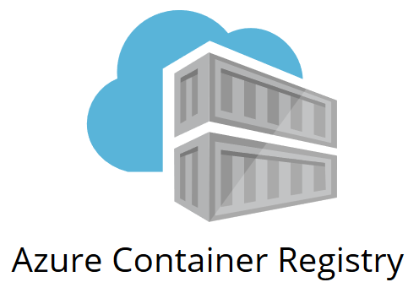
5. Azure Servers

Slide 19
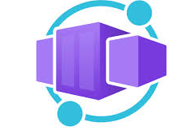
Overview of Azure Cloud Service
Azure Virtual Machine
Azure Container Registry
Azure Container App
Jenkins Virtual Machine
HTTP Hosting Servers
Asset Store Container Storage
DAMB Container Storage
Asset Store Container Instances >> Client & Server
DAMB Container Instances >> Client & Server

Slide 20
List of Azure VM
Jenkins Machine (jenkins-ubuntu-dev-test) - Ubuntu 24.04
Jenkins Daemon (systemd)
SonarQube Daemon (systemd)
Nginx for Reverse Proxy (systemd)
: This is the primary virtual machine for our DevOps team. Jenkins and SonarQube are running on this machine as system daemons.
Docker and Unity Editors are installed on this machine for project builds.
DLX Test Webhost Server (dlx-webhost) - Ubuntu 20.04
LTIjs Daemon (PM2)
Mongo Database (systemd)
Apache for Reverse Proxy (systemd)
: This is the test LTI deployment server for DLX projects. The LTIjs service is registered as an External Learning Tool on Moodle and eConestoga.
We can use this server to test and develop the DLX LTI deployment process.
DLX Deployment Webhost Server (dlx-econestoga) - Ubuntu 24.04
: This is the production LTI deployment server for DLX projects. The LTI.js service is registered as an External Learning Tool on Moodle and eConestoga.
This server will be used as the primary DLX WebGL hosting server on eConestoga.
LTIjs Daemon (PM2)
Mongo Database (systemd)

Slide 21
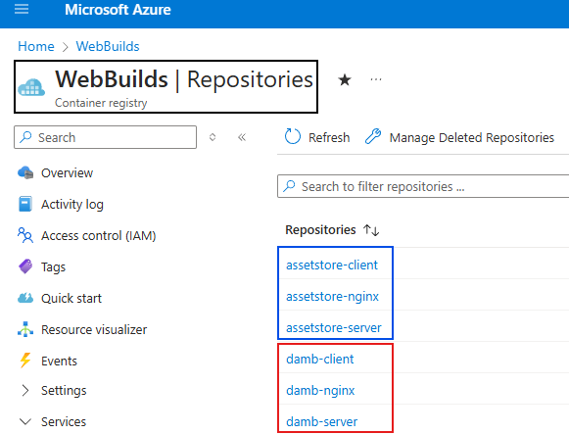
Azure Container Registry
What is Container Registry?
How Container Registry looks like?
: A Container Registry is a central repository for storing and managing container images. (Like Docker Hub)
: Currently, we manage three different images in each JS project. (Six in total).
Client Image
Server Image
Proxy Server Image
It allows developers to build, push, pull, and deploy Docker container images efficiently.
Bitbucket = Storing and Managing source code
Container Registry = Storing and managing container images by version
Build Result of DLX Project = WebGL
Build Result of JS Project = Docker image
WebGL = Stored on Web Host Server
Docker image = Stored on ACR

Slide 22
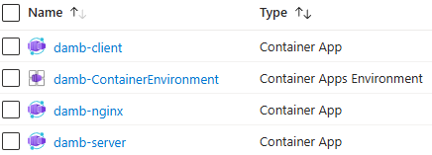
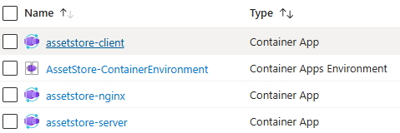
Azure Container App
What is Container App?
How Container App looks like?
: A Container App is an application instance that allows running a service without directly managing a physical computer or virtual machine.
: The number of container apps are the same as the number of containers on ACR (Six in total)
Client Image
Server Image
Proxy Server Image
It allows developers to build, push, pull, and deploy Docker container images efficiently.
What if we don't have Container App?
1. Physical computer or virtual machine is required
2. More difficult to updating a service
3. Image becomes heavier because of OS layer

Slide 23
Thank you

